Slide 1

Exploring Generative AI & Agentic AI
Module 7 — Understanding AI that creates and acts autonomously

Slide 2

Your Learning Journey Today
In this 60-minute module, you'll explore two transformative AI capabilities that are reshaping how we work and create.
01
Understand Generative AI
Discover how AI creates new content from text to images
02
Explore Agentic AI
Learn about AI systems that act autonomously
03
Navigate Opportunities & Risks
Balance innovation with responsible oversight
04
Apply Best Practices
Collaborate effectively with autonomous AI

Slide 3

What is Generative AI?
Generative AI creates new content—text, images, audio, video, or code—by learning patterns from massive datasets and producing outputs that resemble human-created work.
Text & Conversation
Images & Design
ChatGPT, Claude, Bard transform how we communicate and draft content
DALL·E, MidJourney, Stable Diffusion bring visual ideas to life
Music & Audio
Code Assistance
AIVA, Soundraw compose original soundtracks and audio
GitHub Copilot accelerates software development
Key Insight: Generative AI amplifies human creativity but requires your guidance through prompts, context, and iteration. It doesn't replace human vision or judgment—it enhances it.
Discussion prompt: "Have you used AI to create something from scratch? What worked well, and what didn't?"

Slide 4
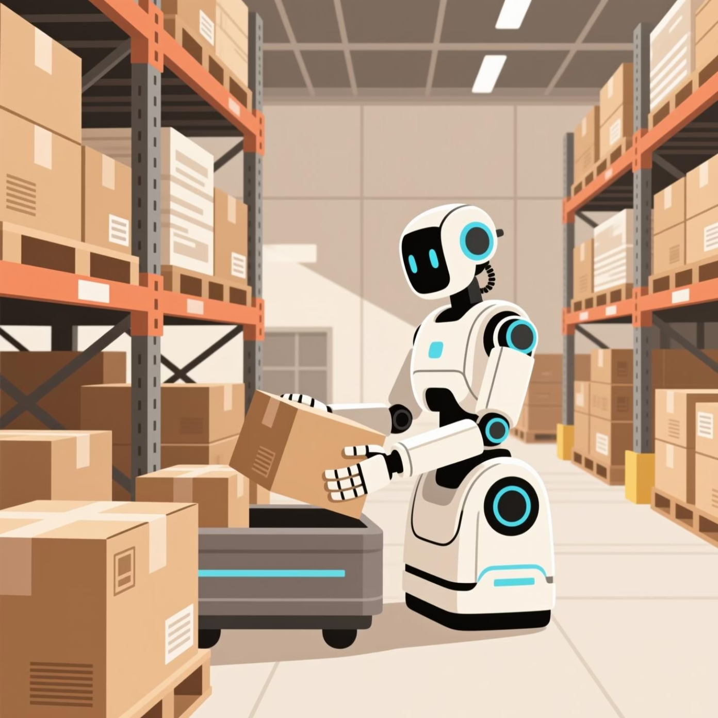

Understanding Agentic AI
Unlike standard AI tools that wait for your commands, Agentic AI can act autonomously, making decisions and executing sequences of tasks with minimal human input. These systems function as intelligent agents working toward specific goals.
Real-World Examples
Autonomous robots performing warehouse operations and deliveries
AI assistants managing complex scheduling across teams
Workflow agents that analyze data and take sequential actions
Remember: Agentic AI is powerful but requires careful oversight and accountability.
How Agentic AI Differs from Standard AI
Feature
Standard AI
Agentic AI
Human Input
Always required
Sometimes operates independently
Decision Making
Follows prompts
Prioritizes and sequences actions
Autonomy Level
Low
Medium to high
Examples
ChatGPT, DALL·E
Auto-GPT, autonomous drones, workflow bots
Discussion prompt: "What benefits and challenges might arise if AI could make autonomous decisions?"

Slide 5
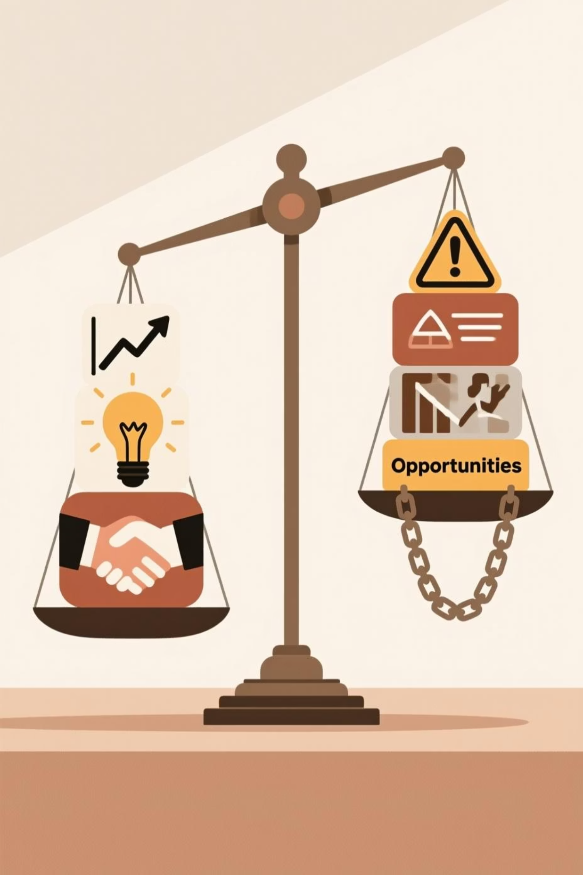
Opportunities & Risks
Opportunities
Risks
Boost Efficiency
Unintended Consequences
Automate repetitive tasks and free up time for strategic work
Autonomous actions may produce unexpected or harmful outcomes
Enhance Creativity
Amplified Errors
Generate new ideas, content variations, and innovative solutions
Bias, inaccuracies, or misaligned goals can scale rapidly
Support Decision-Making
Ethical Concerns
Leverage data analysis and simulations for better insights
Privacy, security, and accountability challenges emerge
Real Scenario: An agentic AI scheduling meetings could double-book appointments or miss critical priorities without proper human oversight and guardrails.
Consider: How do we balance AI autonomy with human oversight in your organization?

Slide 6

Best Practices for Working with Generative & Agentic AI
Responsible AI collaboration requires intentional practices that keep humans accountable while leveraging AI capabilities effectively.
01
02
03
Define Clear Goals
Monitor Outputs
Iterate & Refine
Be explicit and specific about desired outcomes and success criteria
Review AI-generated content or decisions before taking action
Continuously adjust prompts, parameters, and feedback for better results
04
05
Understand Limitations
Apply Ethics & Privacy
Know what AI can and cannot do—recognize edge cases and failure modes
Protect sensitive data, ensure fairness, and prevent potential harm
Critical Reminder: Humans are ultimately accountable for AI outputs and decisions. Responsible use means treating AI as a tool for augmentation, not replacement.

Slide 7



Activity 1 — Generative AI Experiment
Time: 15–20 minutes
Your Challenge
Experience firsthand how Generative AI works by creating content and refining it through iteration.
Select Your Project
Choose one: generate text, create an image, compose music, or write code
Generate Initial Content
Use a Generative AI tool to produce your first output
Iterate & Refine
Adjust your prompts based on what you observe and improve results
Debrief Questions
What did the AI do well?
Where did it misunderstand your instructions?
How could human input improve the results?
How might this content be applied responsibly in real-world scenarios?

Slide 8

Activity 2 — Agentic AI Scenario Simulation
Time: 15 minutes (Optional)
The Scenario
An agentic AI system is assigned to autonomously schedule appointments, send reminders, and manage a small project with minimal human intervention.
Your Task
Working individually or in small groups, identify:
1
Potential Benefits
What efficiencies or improvements could this create?
2
Possible Errors or Risks
What could go wrong without oversight?
3
Oversight Strategies
What safeguards would you implement?
Debrief Questions
When should humans intervene in autonomous AI processes?
How can unintended consequences be prevented proactively?
What checks and balances are necessary for safety and accountability?

Slide 9

Connecting the Dots
The skills you've developed throughout this training program come together powerfully when working with Generative and Agentic AI.
Generative AI
Agentic AI
Core Skills Apply
Enhances creation and ideation, amplifying your creative capabilities
Enables autonomous action, executing complex tasks independently
Clear prompts, iteration, ethical awareness, and human oversight remain essential
Reflection Prompt
"Thinking about your daily AI use, which tasks could safely be delegated to an agentic AI, and where would human judgment remain critical?"
Take a moment to consider how you'll apply these insights in your work. The future of AI collaboration depends on informed, responsible practitioners like you.

Slide 10
Module 7 — Facilitator Speaker Notes
1
2
Slide: Generative AI
Slide: Agentic AI
"Generative AI can produce text, images, music, and code. It's amazing for brainstorming and prototyping—but it still needs your guidance and critical thinking to produce truly valuable results."
"Agentic AI acts as an autonomous assistant. It can plan, execute, and decide—but its autonomy requires careful oversight and clear responsibility frameworks. We're the humans in the loop."
3
4
Slide: Opportunities & Risks
Slide: Best Practices
Discuss benefits: efficiency gains, creative enhancement, data-driven insights. Discuss risks: errors, bias amplification, ethical challenges. Encourage critical thinking about when and how to allow AI autonomy.
"Define clear goals, monitor outputs carefully, iterate based on results, understand AI limitations, and always apply ethics and privacy safeguards. Responsible use keeps AI as a tool for augmentation, not replacement."
Facilitation Tips: Encourage open discussion, share real examples, and create space for learners to voice concerns and questions about AI autonomy and responsibility.

